Slide 1
The Deep Dark
By: Matthew Brock and Max Tauro

Slide 2
Release Schedule
Release Name | New incremental features of this release
Alpha | Have Animated Character on screen and Buttons that control the direction of a walking animation
Beta | Get GitHub working, button release detection, and clean up animation
Gamma | Add character movement, camera movement, tilemap, hit detection on the map, and map changing with doors.
Delta | add a bace enime and add fireballs
Epsilon | Make a “Nest” That will spawn The enemies when the character is close and at a set rate untill the “Nest” is destroid
Zeta | Add potions that the character can store one at a time and use when they choose
Eta | Add keys that the character can hold multiples of
Theta | Add door that will be opened by the chorisponding key
Iota | Add the ability to save the state of the game
Kappa | Add the boss at the end of the level
Lambda | Add music
Mu | Add a start menu with Start, Load, New, and Controls
Nu | Add options to the start menu for music and difficulty
Xi | Check points that you can return to when you die
Omicron
Pi
Rho
Sigma
Tau

Slide 3
Overview
The Deep Dark is a top down dungeon crawler
The objective is to navigate the level while avoiding enemies along the way

Slide 4
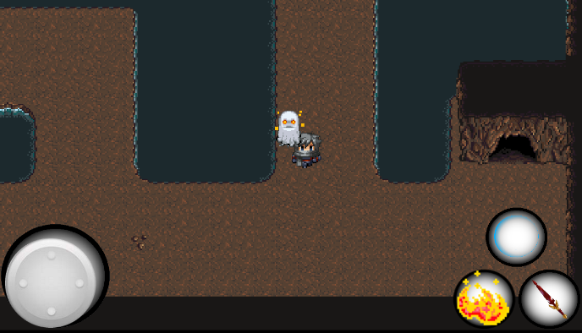
Overview
Main Character
An Enemy
Buttons for atk/def
Touch pad

Slide 5
Controls
we have two main types of controls the buttons and the touchpad
buttons are pretty simple you just load textures for the button pressed and released
a touchpad is also simple you just load textures for the front and back of the touchpad

Slide 6
Controls
To get a touchpad to do anything you can check a percentage that will tell you how far the knob of the touchpad is from the center in terms of x and y
public float getKnobPercentX () {
return knobPercent.x;
}

Slide 7
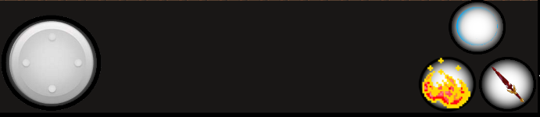
Controls
The buttons are located at the bottom of the screen.
The shield button
The Button to shoot fire
The touchpad controlling all character movement
The button for melee attacks

Slide 8
Maps
to make our maps we used an editor called Tiled
tiled outputs a tmx file which holds each tiles texture and ID
libgdx has something called an OrthogonalTiledMap renderer and renderer which allows you to render the map the you made in Tiled
to make use of the IDs you can use a TiledMapTileLayer which holds the height and width of the tiles as well as the ID on each tile

Slide 9
Map example
public boolean getTileID(float fX, float fY, float nWidth, String sID) {
boolean bCollided = false;
for (nLayerCount = 0; nLayerCount < armMaps[nCurrentMap].tiledMap.getLayers().getCount() - 1; nLayerCount++) {
bCollided = armMaps[nCurrentMap].arclCollisionLayer[nLayerCount].getCell((int) ((fX + nWidth / 4) / tileWidth), (int) (fY / tileHeight)).getTile().getProperties().containsKey(sID);
bCollided |= armMaps[nCurrentMap].arclCollisionLayer[nLayerCount].getCell((int) ((fX + 3 * nWidth / 4) / tileWidth), (int) (fY / tileHeight)).getTile().getProperties().containsKey(sID);
bCollided |= armMaps[nCurrentMap].arclCollisionLayer[nLayerCount].getCell((int) ((fX + nWidth / 2) / tileWidth), (int) (fY / tileHeight)) .getTile().getProperties().containsKey(sID);
}
return bCollided;
}

Slide 10
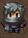

Characters
This is the main character that the user will control
The characters in the game are animated using spritesheets.
sbSpriteBatch.draw(araWalking[nCharacterRotation].getKeyFrame(stateTime,true), fCharacterX, fCharacterY, fCharacterWidth, fCharacterHeight);
The stateTime will indicate which frame of the spritesheet is drawn.
fCharacterX and fCharacterY will determine location and change based on movement.
fCharacterX += fCharacterVelocityX;

Slide 11

Characters
This is the enemy that the user will encounter.
The enemy can be eliminated when hit by fireballs
The code referenced to have enemies chase is:
crosshair.x=0.9(crosshair.x-mouseX)+mouseX-1.5;
from: http://2oi.sgrondin.ca/ss10/Delay.html
fGhostX = (float) (0.98 * (fGhostX - fX) + fX - 1.5); as it appears in our code
To determine whether the Ghost chases the main character we use pythagorean.
fPyth = (float) Math.abs(Math.sqrt(Math.pow(fDx, 2) + Math.pow(fDy, 2)));
if the distance is small enough a boolean is set as true so the main character is chased
this is also used to check if projectiles hit the Character
fPythFire = (float) Math.abs(Math.sqrt(Math.pow(fGhostX - fFireX, 2) + Math.pow(fGhostY - fFireY, 2)));

Slide 12
Menu
to use menus you have to actively change which screen is being shown based on user inputs
to change the screen in main from other classes I made a sudo global variable by having a class that holds an int
to control which screen has input control I made it so that when a screen is rendered the input processor is set to that screens stage

Slide 13
Menu example
public void render() {
nScreen = screenControl.nScreen;
if (nScreen == 1) {
mainMenu.render();
} else if (nScreen == 2) {
characterSelect.render();
} else if (nScreen == 3) {
gameScreen.render();
}
}

Slide 14
Disclaimer: List of known bugs
Back button
Since the implementation of the menus when the back button is pressed in-game, it appears as though the play button is pressed(?)
Sword
The hittest for the sword is quite buggy and inaccurate, it will generally lead to the main characters health dropping to 0
The Sword does not kill enemy at all
The Shield
The Shield can be used to kill the enemy

Slide 15
Object Overview
Main
MainMenu
CharacterSelect
GameScreen
ScreenControl
Enemy
Controls
Map
MainCharacter
FireBalls

Slide 16
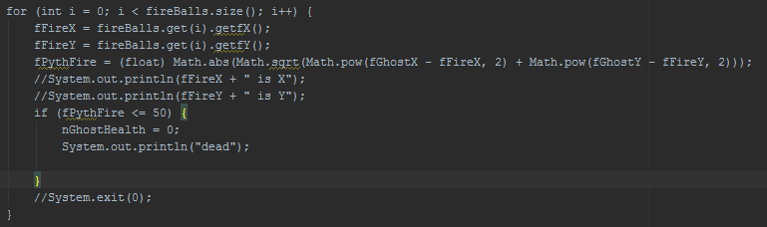
Unique Challenges
Using predefined things that we didn’t fully understand
ex. Touchpad
Scaling with different devices
ex. fCharacterX = 87 * tileWidth - (tileWidth / 2);
Getting the FireBall hit detection

Slide 17
Advanced Data Structures
Array lists
we used an array list for our fireballs so we could add and remove them easily
Maps
The maps that we made with Tiled act as a 2D array and are very similar to a conventional map but they are easier to use

Slide 18
New Programming Concept
Tiled was the main thing that we used that was not covered in class
Thanks to grondin telling us to check it out

Slide 19
Frustrations
gitHub
Trouble merging code
Scaling
Early on we had difficulties scaling to different devices, especially with scaling spawn locations
CharacterX = 87 * tileWidth - (tileWidth / 2);
using tileWidth and tileHeight adjusted the scaling for other devices
Android Studio
Android Studio is not reading .java files as Java files

Slide 20
Notes to future programmers
Learn libGdx structure before trying to do things
Learn to use GitHub efficiently early on
Keep GitHub organized

Slide 21
Github and sources
Path to our Github: https://github.com/MatthewBrock/TheDeepDarkTaurock
Sources
http://2oi.sgrondin.ca/ss10/Delay.html
http://stackoverflow.com/questions/21488311/libgdx-how-to-create-a-button
http://obviam.net/index.php/getting-started-in-android-game-development-with-libgdx-create-a-working-prototype-in-a-day-tutorial-part-1/
https://github.com/libgdx/libgdx/wiki/2D-Animation
http://www.youtube.com/watch?v=qik60F5I6J4/

